Slide 1
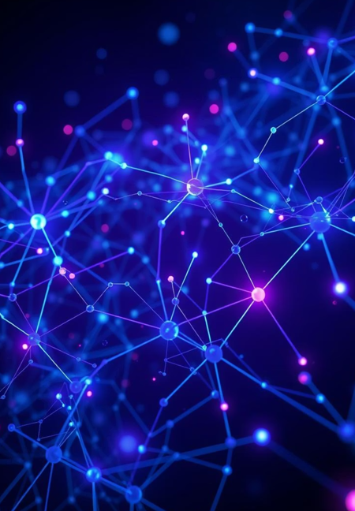
Convolutional Neural Networks : From Neurons to Deep Learning
This presentation delves into the fundamental concepts of Convolutional Neural Networks (CNNs), starting from the basics of neural networks and exploring why CNNs emerged as a powerful solution for specific tasks, particularly in image processing. We will dissect the core components of CNNs, including convolution, activation functions, and pooling layers, providing both descriptive explanations and mathematical insights.

Slide 2
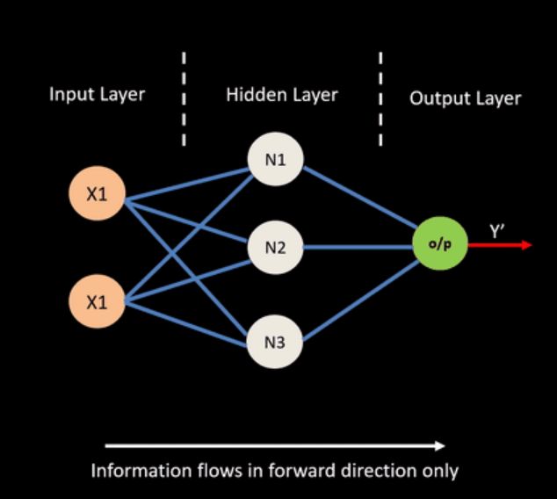
The Foundation: Artificial Neural Networks (ANNs)
To appreciate the innovation of CNNs, it's crucial to understand their predecessor: Artificial Neural Networks (ANNs), often referred to as Multi-Layer Perceptron's (MLPs). ANNs are computational models inspired by the structure and function of biological neural networks. They consist of layers of interconnected "neurons" or nodes, where each connection has a weight, and each neuron has an activation function. Information flows from an input layer, through one or more hidden layers, to an output layer.
How ANNs Work :
Input Layer: Receives the raw data, such as pixel values of an image or features of a dataset.
Hidden Layers: Perform computations on the input, transforming the data through weighted sums and activation functions. These layers learn complex patterns and representations.
Output Layer: Produces the final result, such as a classification probability or a regression value.
Weights and Biases: These are the parameters learned by the network during training. Weights determine the strength of connections, and biases adjust the output of a neuron.

Slide 3
Limitation of ANN : Beginning of Convolutional Neural Network
The limitations of traditional ANNs when processing visual data led to the development of Convolutional Neural Networks (CNNs).
Handling High-Dimensional Data
Images are large datasets. An Image consist of pixel has 10,000 features or more than it for color image. Fully connected layers in ANNs would require millions of parameters, making training interactable.
Computational Efficiency
Training ANNs—especially deep neural networks—requires performing millions or billions of matrix multiplications.
Large models can take days or even weeks to train.
Why CNN :
CNNs capture inherent patterns in images, learning simple features(edges, corners) in early layers and more complex feature (part of objects, entire objects) in deeper layers.
The localized processing and parameter sharing drastically reduce the computational complexity compared to fully connected networks, making CNNs feasible for large-scale image datasets.

Slide 4
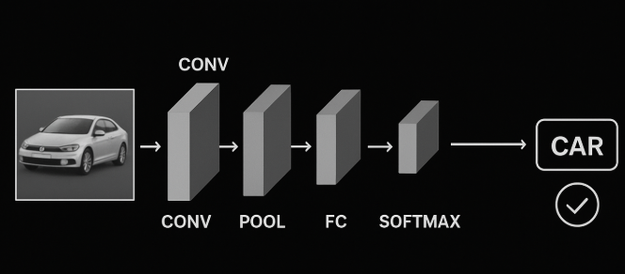

Convolution Neural Network :
A typical CNN architecture is composed of a series of interconnected layers, each performing a specific function. Understanding the flow of data through these layers is key to grasping how CNNs process and learn from visual information.
The detailed interpretation of each of the interconnected layers in upcoming slides .
Convolutional Layers (Conv)
Activation Layers (ReLU)
Pooling Layers (Pool)
Flatten Layer
Fully Connected Layers (FC)
Output Layer

Slide 5
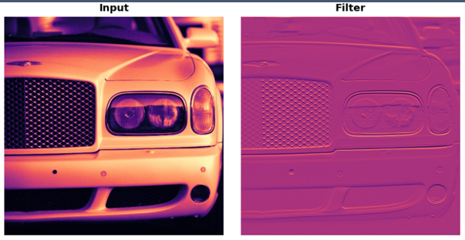
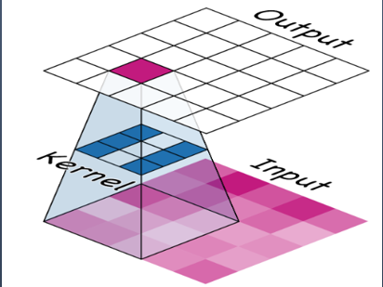
Convolutional : The Core of CNNs
The convolutional layer is the foundational building block of a CNN. It performs a mathematical operation called convolution, which involves sliding a small filter (also known as a kernel or feature detector) across the input data (e.g., an image) to produce a feature map. This process extracts relevant features from the input.
What is Convolution?
In the context of CNNs, convolution is a specialized kind of linear operation. It applies a filter (a small matrix of weights) to local regions of the input, computing the dot product between the filter and the input patch. This operation highlights specific features like edges, textures, or patterns.
In simple word we can say that :
Convolution as a tiny magnifying glass (a filter) that slides across the whole picture.
This magnifying glass looks for a pattern (like an edge, corner, or texture).
Wherever it finds that pattern, it marks it.
Then the computer knows where important features are
How it Applies:
The filter slides across the entire width and height of the input, performing the dot product at each position. As the filter moves across the image, it highlights regions where these features are present, effectively extracting relevant information.

Slide 6
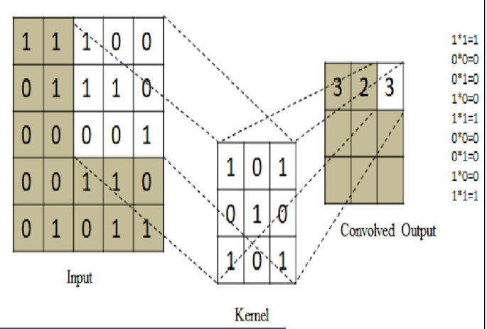
Mathematical Description of CNN :
S(i, j) = Σ Σ I(i+m, j+n) * K(m, n)
Where:
I is the input image.
K is the convolutional kernel (filter).
S is the feature map (output).
i, j are the coordinates in the output feature map.
m, n are the coordinates within the kernel.
Eg.
Input Image (I): [1 1 1 0 0]
[0 1 1 1 0]
[0 0 0 0 1]
[0 0 1 1 0]
[0 1 0 1 1]
Filter (K): [1 0 1]
[0 1 0]
[1 0 1]
S(1, 1) = (1*1 + 1*0 + 1*1 + 0*0 +0*1 + 0*0 + 1*0 + 0*0 + 1*1) = 3
[3 2 3]
[2 3 3]
[0 2 3]
Conv output
=

Slide 7
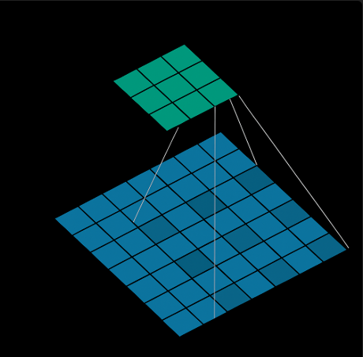
Variations of CNN :
(1) Dilated Convolution :
What they are ?
Dilation is adding space inside the filter to see more area without increasing filter size.
Dilated convolution is consist of normal convolution with gaps(dilation) .
Dilated convolution is a smart way to zoom out your vision without increasing filter size or losing data. ..ils.
The dilation rate = number of dilation + 1 .
Dilation rate 1 is called normal convolution.
Why They're Crucial ?
To capture large-scale features (like big objects) without increasing filter size .
When detecting objects of different sizes, preserving spatial or needing a large receptive field.
Used in object detection, image generation, and feature extraction in CNNs.
How They Work ?
Insert zeros between filter weights; slide the dilated filter over the image like normal convolution; effectively “looks farther” at the image.
In this figure , convolution with dilation rate 2

Slide 8
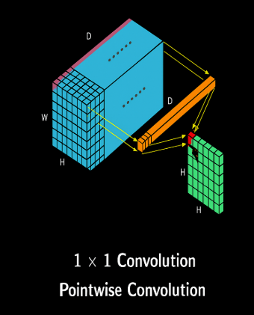
(2) Pointwise Convolution :
What they are ?
A 1×1 convolution means the filter has height = 1 and width = 1 , but spans the entire depth (D) of the input. It looks at one pixel at a time but uses all its color channels.
Instead of looking at a spatial neighborhood (like 3×3 or 5×5 filters), it looks at one spatial location at a time but processes all channels (depth) at once.
Why They're Crucial ?
To make our model faster and smaller .
To change the number of features in an image.
To combine information from all channels at each point.
How They Work ?
Take the 1x1xD filter and multiply the weights of filter with each value of pixel , add them and get new number .
Keep it all over area of image and will get new output with size WxH.

Slide 9
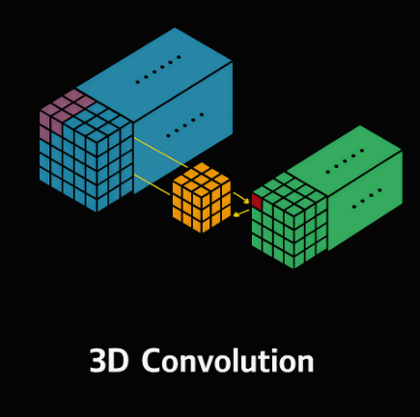
(3) 3D Convolution :
What they are ?
In 2D convolution, the input is typically a 2D image (height x width ).
In 3D convolution, the input is a 3D volume, such as a video sequence (frames x height x width ), a 3D medical scan (depth x height x width ).
Why They're Crucial ?
Extends kernel to depth/time → kernel slides in (x, y, t) or (x, y, z).
Local motion, volumetric continuity, and spatio-temporal dependencies are all learned directly.
How They Work ?
Take a 3D filter, slide it across the entire input volume, multiply its values with the corresponding input values (element-wise), add them up, and place the result as a single value in the feature map.

Slide 10
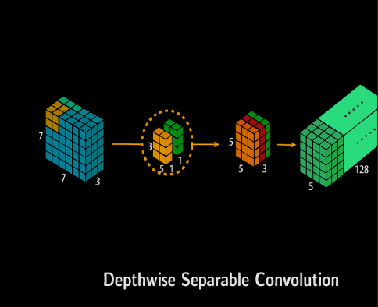
(4) Depthwise Separable Convolution :
What they are ?
A smarter version of convolution that first handles each channel separately, then mixes them. It makes CNNs faster and lighter.
Depthwise Separable Convolution break a normal convolution into two small part .
Depthwise Convolution → looks at each channel (color) separately.
Pointwise Convolution (1×1 Convolution) → mixes all the channels together.
Why They're Crucial ?
A normal convolution is heavy (like carrying all your school books at once.)
Depthwise Separable Convolution is lighter and faster (like carrying one subject’s books at a time, then arranging them).
How They Work ?
Take a filter and look it’s all color(RGB) at once.
But here, we do something different:
Use one filter for Red,
one filter for Green,
one filter for Blue.
Each filter slides across its own color channel only.
After Depthwise, we have 3 separate results (Red result, Green result, Blue result).
Now we use a 1×1 filter to mix them together.

Slide 11

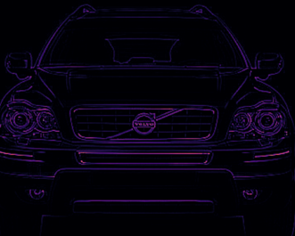
Activation Layer:
Input(after convolution)
What they are ?
Activation functions introduce non-linearity into the network, allowing it to learn complex patterns and relationships beyond simple linear transformations.
Detect that feature within the filtered image.
Why They're Crucial ?
Without non-linearity, a neural network, no matter how many layers it has, would essentially just be performing a linear regression. Activation functions enable the network to approximate any continuous function.
By introducing non-linearity, activation functions enable neural networks to learn and recognize complex patterns, making them suitable for tasks like image classification, natural language processing, and more.
Activation
How They Work ?
After a neuron computes a weighted sum of its inputs and adds a bias, the activation function determines whether and to what extent that neuron should "fire" or be activated.

Slide 12
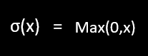
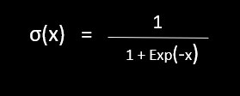
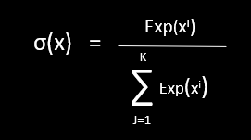
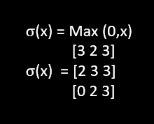
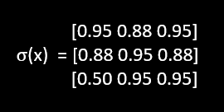
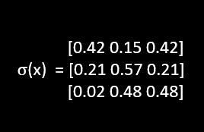
Mathematical Description of Activation function :
Let (w.x) be the output of convolution and b is the bias , σ(x) is activation function then:
F(x) = σ(w.x+b)
Where x is features ,
w is weight of features.
F is output functions from activation function like Relu , Sigmoid etc.
Common Examples and Use Cases:
1
2
3
ReLU (Rectified Linear Unit)
Sigmoid
Softmax
Function: f(x) = max(0, x). Outputs x if x > 0, else 0.
Use Case: Most common choice for hidden layers due to computational efficiency and combating vanishing gradients.
Function: S-shaped curve, squashes values between 0 and 1. Use Case: Output layer for binary classification problems (e.g., predicting probability).
Function: Converts a vector of numbers into a probability distribution.
Use Case: Output layer for multi-class classification, where the sum of probabilities for each class equals 1.

Slide 13
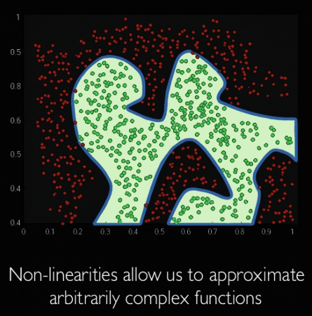
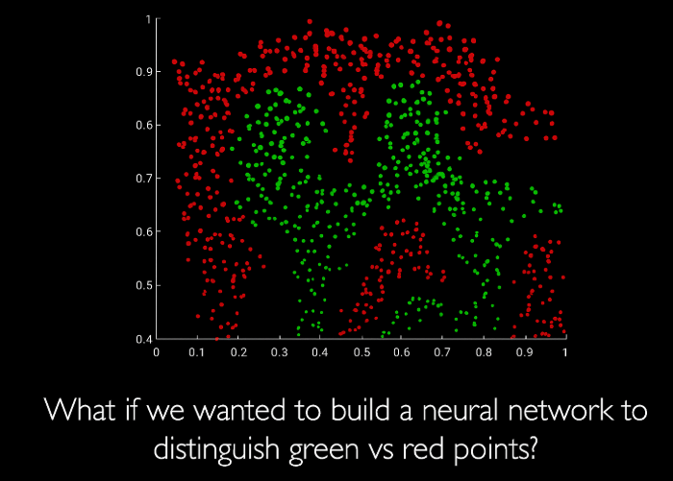
Importance of Activation functions :
The purpose of activation function is introduce non-linearities into network.

Slide 14
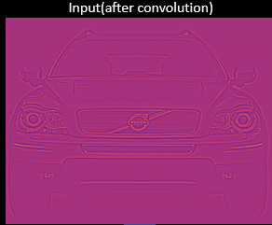
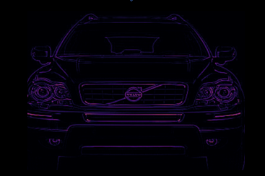
Use case of Activation functions :
(1) Use case of ReLu :
Step_1 :
Top Image (Input after convolution)
See a car of output of convolution layer.
After that take it as input of activation function.
It has both positive values and negative values (some parts bright, some dull).
Step_2 :
Activation (ReLU)
Now we pass this raw output through ReLU activation.
If the value is less than 0 (negative) → make it 0.
If the value is 0 or more (positive) → keep it as it is.
ReLU removes the negative parts and only keeps useful (positive) information.
ReLu
Step_3 :
Bottom Image (After ReLU activation)
In the bottom image, the car looks clearer.
That’s because the negative values were cut off, and only important feature remain.
This makes it easier for the neural network to recognize the object (the car).
Note : ReLU highlights only the positive edges, making the car outlines clear.

Slide 15
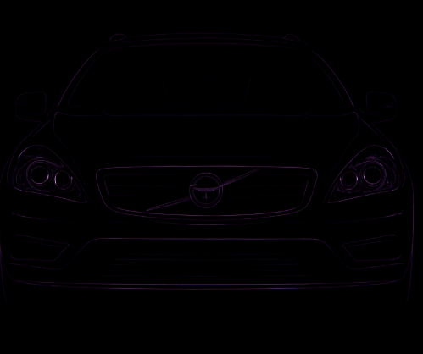
(2) Use case of Sigmoid :
Step_1 : Top Image (Input after convolution)
See a car of output of convolution layer.
After that take it as input of activation function.
It has both positive values and negative values (some parts bright, some dull).
Step_2 : Activation (Sigmoid)
Very large positive values → become 1 (bright white).
Very large negative values → become 0 (black).
Values around 0 → become 0.5 (grayish).
Sigmoid
Step_3 : Bottom Image (After Sigmoid activation)
The background looks almost black because weak/negative signals went close to 0.
The edges and outlines of the car glow faintly (between 0.5 and 1), so they stand out.
This makes the car appear as if it’s drawn with neon outlines on a black background.
Note : If we want the network to say “Probability this is a car = 0.9”, we use Sigmoid.

Slide 16

Pooling Layers: Downsampling for Efficiency
What they are ?
A pooling layer in a convolutional neural network (CNN) reduces the spatial dimensions of feature maps (the output of convolutional layers) while retaining the most important information. This dimensionality reduction helps to decrease the number of parameters and computations in subsequent layers, making the network more efficient and less prone to overfitting.
Why They're Crucial ?
Pooling layers reduce the spatial dimensions (width and height) of the feature maps, which helps to:
Reduce computational cost.
Control overfitting.
Make the network more robust to small shifts or distortions in the input (translation invariance).
How They Work ?
A pooling operation slides a window (like a filter) over the input and takes a summary statistic of the values within that window. The two most common types are:
Max Pooling: Selects the maximum value within the window.
Average Pooling: Computes the average of the values within the window.
Max pooling is often preferred as it captures the most salient features, preserving important information while reducing dimensionality.

Slide 17
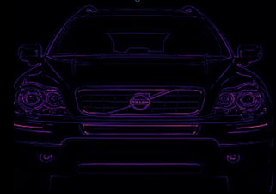
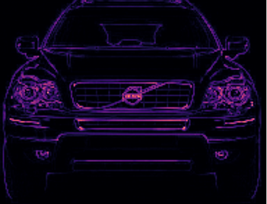
Impact on Network :
Reduces the number of parameters and computations in the network, speeding up training.
Input(After Activation)
Helps control overfitting by reducing the spatial size of the representation.
Introduces a degree of translation invariance, meaning the network can recognize features even if their precise location in the input shifts slightly.
Example : (1) Max Pooling (Pool most dominant feature in each region) .
Here is example of max pooling with size(2x2) and stride 1.
[3 2 3]
[2 3 3]
[0 2 3]
[3 3]
[3 3]
Pooling
Maxpool2D(pool_size =2, strides = 1)
Note : In the max pooling , we can pool most powerful features easily .

Slide 18
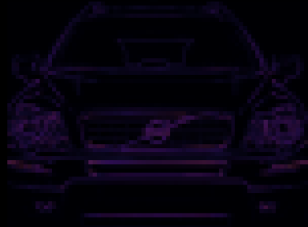
Input(After Activation)
Example : (2) Average Pooling (Pool general trend ,smoothing , not sharp).
Here is example of Average pooling with size(2x2) and stride 1.
[3 2 3]
[2 3 3]
[0 2 3]
AvgPool2d(pool_size=2, stride=1)
[2.50 2.75]
[1.75 2.75]
pooling
Note : In average pooling , we can pool generalized feature of input image that means we don’t want to lose any information that’s why we take average features in each region.

Slide 19
Other Type of Pooling :
Global Max Pooling: Takes the maximum value across the entire feature map.
Global Average Pooling: Computes the average of all values in the feature map.
[3 2 3]
[2 3 3]
[0 2 3]
GlobalMaxPooling2D()
Global Max Pooling , extract most dominant feature from entire input , in the given example the most dominant feature related to pixel value 3.
[3]
[3 2 3]
[2 3 3]
[0 2 3]
GlobalAveragePooling2D()
[2.3]
Global Average Pooling , extract generalized feature from entire input , in the given example the generalized feature related to pixel value 2.3 .

Slide 20
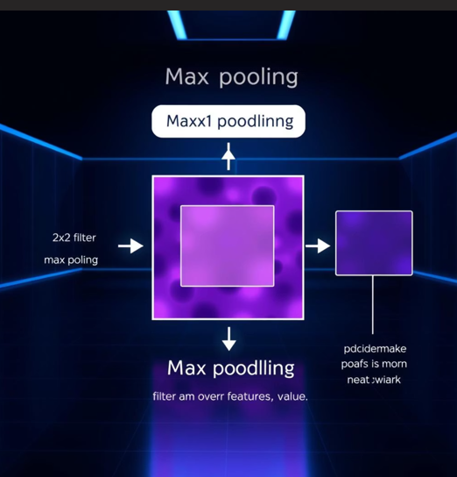
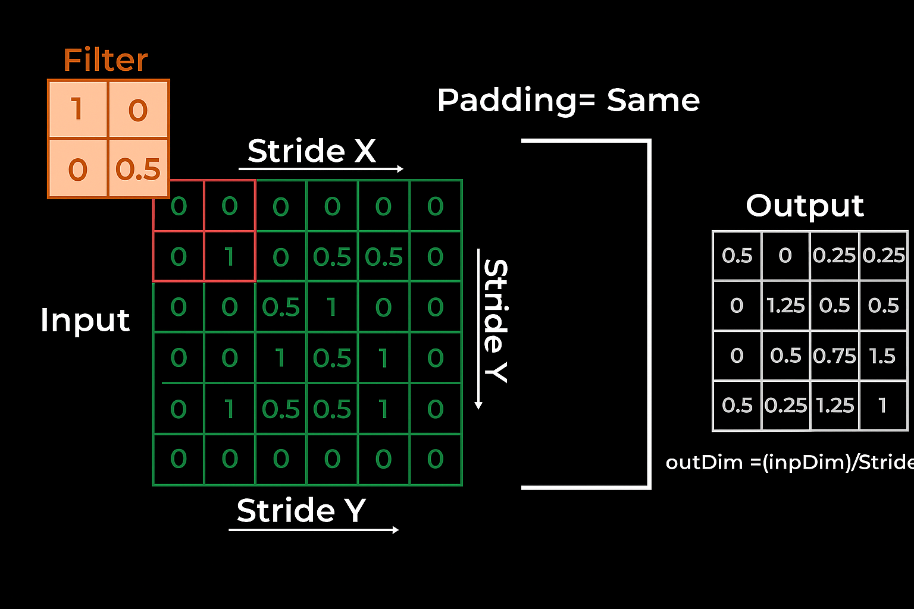
Key Factors to Consider for Optimizing Pooling Layer:
(1)Pooling Window Size:
The size of the pooling window affects the degree of down sampling.
A larger window results in more aggressive down sampling but may lose important details.
(2)Stride:
The stride determines how much the pooling window moves at each step.
A larger stride results in greater. dimensionality reduction.
(3)Padding:
In some cases, padding is used to ensure that the pooling operation covers the entire input feature map.

Slide 21
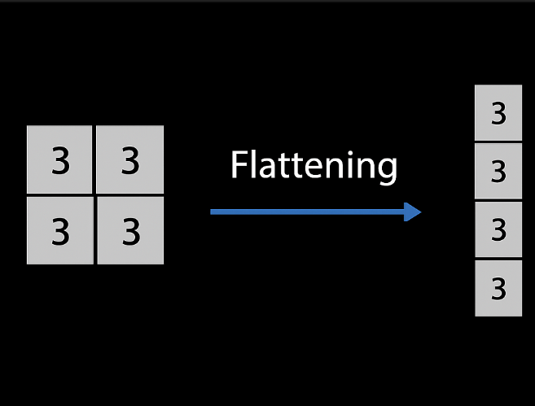
Flatten Layer :
What they are ?
After several convolutional and pooling layers, the 3D feature maps are flattened into a 1D vector. This prepares the data for input into a fully connected neural network.
Why They're Crucial ?
Dimensionality Mismatch:
Convolutional and pooling layers in a CNN operate on multi-dimensional feature maps (e.g., height x width x channels). These layers are designed to extract spatial features from the input data.
Fully Connected Layer Requirements:
Fully connected layers, which are typically used for classification or regression tasks at the end of a CNN, require a one-dimensional vector as input. Each neuron in a fully connected layer connects to every neuron in the preceding layer, and this structure necessitates a flat input.
How They Work ?
The flatten layer takes these multi-dimensional feature maps and converts them into a single, long vector. This is achieved by essentially "unrolling" the tensor – taking all the elements from the feature maps and arranging them sequentially into a single row or column.

Slide 22
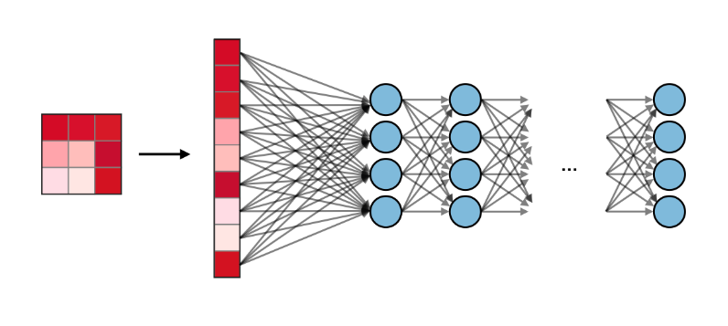
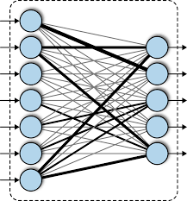
Fully Connected Layers (FC):
What they are ?
A fully connected layer is a traditional neural network layer where each neuron is connected to every neuron in the preceding layer .
One or more fully connected layers receive the flattened feature vector. These layers learn non-linear combinations of the high-level features extracted by the convolutional layers and map them to the output space.
Why They're Crucial ?
Fully connected layers are crucial for tasks like image classification, where they take the output of the convolutional and pooling layers (often after flattening the feature maps) and use it to make predictions.
How They Work ?
It acts like a traditional neural network layer, where each connection has a weight and bias. The FC layer combines the extracted features to make final predictions (e.g., classification scores). Mathematically, it performs a weighted sum followed by an activation function.
Mathematically, a fully connected layer computes:
y=f(Wx+b)
where x is the flattened input, W is the weight matrix, b is the bias vector, and f(⋅) is the activation function.

Slide 23
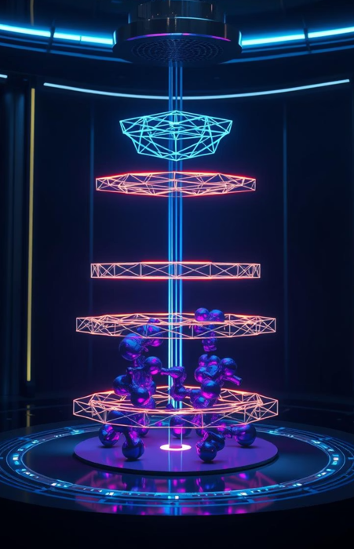
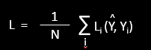
Output Layer (Loss Function):
What they are ?
The loss function is the compass of a neural network, guiding it towards the optimal solution by quantifying the error between predictions and ground truth.
Why They're Crucial ?
It determines the form of the result by using an appropriate function –
Softmax for classification , Linear for regression, etc.
Without it , the network wouldn’t translate learned patterns into meaningful, interpretable outputs.
How They Work ?
A loss function measures how far the CNN’s prediction is from the actual target. It takes the model’s output and the true label, compares them, and returns a single number
representing the “error”.
The training process tries to minimize this number by adjusting the network’s weights, so predictions get closer the correct answers.
A loss function tells how good our model is .
Given dataset of examples….
{(X_{i} +Y_{i})}^{N} _{i=1}
,where X_{i} is image and Y_{i} is label.
Loss over the dataset is :
,where Y is predicted label with function of weight and input image.
^

Slide 24

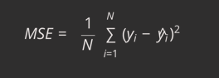
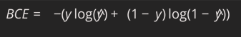
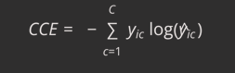
Detailed Look at Key Loss Functions :
The choice of loss function is task-dependent and significantly impacts model performance. Here are some of the most prominent loss functions used in CNNs:
Mean Squared Error (MSE):
Use Case: Regression problems.
Explanation: Calculates the average of the squared differences between predicted and true values. It heavily penalizes large errors, making it sensitive to outliers. The squaring ensures that the loss is always non-negative and differentiable.
Binary Cross-Entropy:
Use Case: Binary classification (e.g., predicting 0 or 1).
Explanation: Measures the difference between two probability distributions. It penalizes predictions that are confident and wrong more heavily. When the true label y is 1 .
Categorical Cross-Entropy :
Use Case: Multi-class classification (one-hot encoded labels).
Explanation: An extension of binary cross-entropy for more than two classes. It sums the negative log probabilities for the true classes. The model is penalized more when it assigns a low probability to the correct class. Requires target labels to be one-hot encoded.

Slide 25
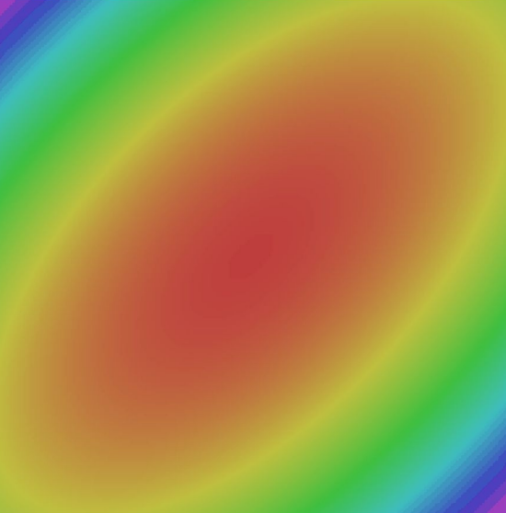
Advance Optimization Techniques :
While selecting the right loss function is crucial, effective optimization also relies on smart algorithms and techniques that guide the model during training. These strategies aim to find optimal weights efficiently and prevent common training pitfalls.
Adaptive Learning Rate Optimizers :
Optimizers like Adam, RMSprop, and Adagrad dynamically adjust the learning rate for each parameter based on past gradients. This allows for faster convergence and often better performance by adapting to the local landscape of the loss function. Adam is generally a strong default choice.
Regularization Techniques :
Methods like L1/L2 regularization and Dropout are essential to prevent overfitting, especially in complex CNN architectures. L1 and L2 penalize large weights, while Dropout randomly deactivates neurons during training, forcing the network to learn more robust features.
Batch Normalization :
Normalizes the activations of intermediate layers, stabilizing training and allowing for higher learning rates. It reduces the "internal covariate shift," making the network less sensitive to initialization and improving generalization. Typically applied after convolutional layers and before activation functions.

Slide 26
Hyperparameter Tuning : The Art of Model optimization
Learning Rate :
Perhaps the most critical hyperparameter. Too high, and the model may diverge; too low, and training will be excessively slow or get stuck in local minima. Common initial values range from 1e-2 to 1e-4.
Batch Size :
The number of samples processed before the model's internal parameters are updated. Larger batches can provide a more accurate estimate of the gradient but require more memory and can lead to poorer generalization. Smaller batches offer more frequent updates and can escape sharp minima.
Number of Epochs :
The number of full passes over the entire training dataset. Early stopping based on validation set performance is crucial to prevent overfitting.

Slide 27
Advanced Concepts in CNNs :
Beyond the fundamental building blocks, several advanced concepts contribute to the robustness and performance of modern CNNs.
Weight Sharing: A Powerful Optimization
In CNNs, the same set of filter weights is applied across all spatial locations of the input image. This means instead of learning different weights for each pixel, the network reuses the same filter when sliding (convolving) across the image.
Why They're Crucial ?
Reduced Parameters:
(1) In a fully connected layer, each input pixel connects to each neuron with its own weight → huge number of parameters.
(2) With weight sharing, the same small filter (e.g., 3×3 or 5×5) scans the whole image.
(3) This reduces parameters drastically.
Translation Invariance:
Because the same filter is used everywhere, if a feature (like an edge) appears in one part of the image, the network
can detect it regardless of its position. This is crucial for robust image recognition.
Feature Detection:
(1) Fewer parameters mean lower risk of overfitting.
(2) The network focuses on feature detection rather than memorizing positions.

Slide 28
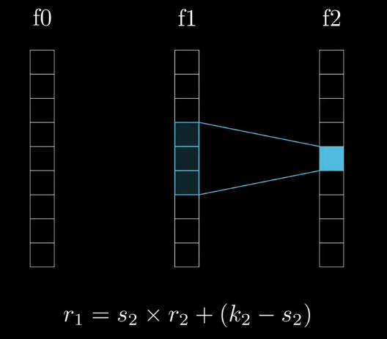
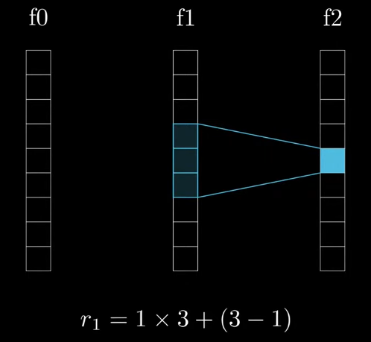
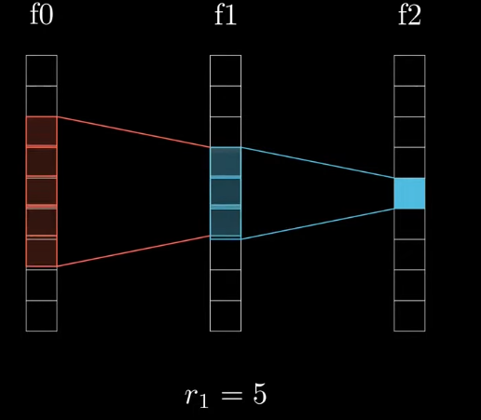
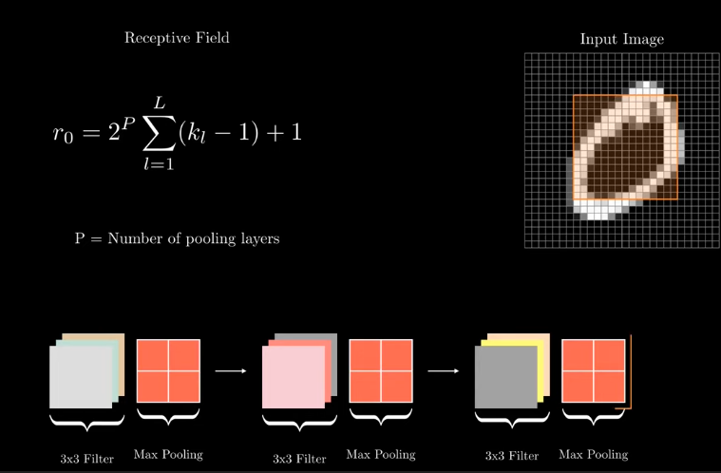
Receptive Field:
Definition :
The receptive field of a neuron in a convolutional layer refers to the region in the input image that influences that neuron's output. It's the area of the input "seen" by a specific filter during convolution.
Building Hierarchy :
As information passes through multiple convolutional layers, the receptive field of neurons in deeper layers grows larger. This allows later layers to detect more complex, abstract features by combining simpler features from previous layers.
Importance :
Understanding receptive fields helps in designing network architectures, determining appropriate filter sizes, and interpreting what a CNN is learning at different depths. Larger receptive fields enable context-aware predictions.

Slide 29
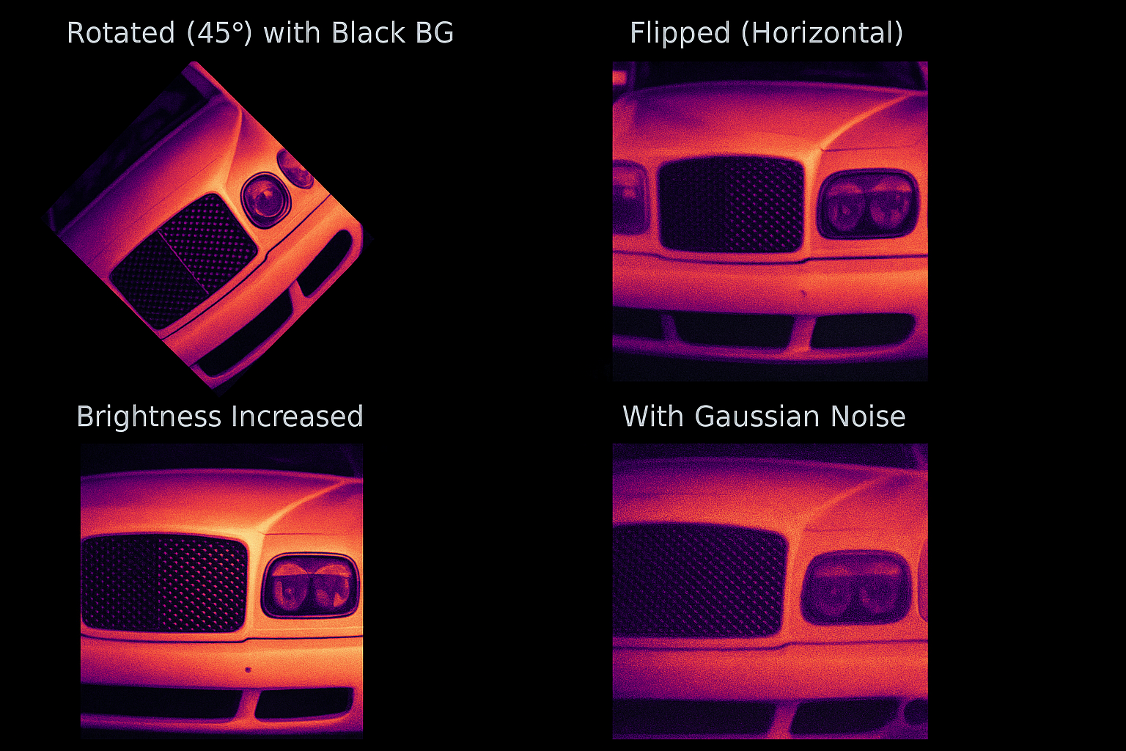
Data Augmentation :
Definition :
Data Augmentation means applying transformations to existing images to create new, slightly different versions, while keeping the object/label the same.
This helps models learn to recognize objects in varied conditions (different lighting, orientation, occlusion, etc.) without needing to collect more real-world images.
Why They're Crucial ?
Prevents overfitting.
Makes models robust to real-world variations (camera angle, lighting, noise).
Expands datasets that are small or imbalanced.
Examples :

Slide 30
CASE STUDY _1 : Classification by using CNN

Slide 31
What is Classification ?
Assigning input (like an image) to a specific category (truck, van, car…)
Why CNN ?
Automatically learns features from images, unlike traditional ML.
Learn features in input image through Convolution .
Introduce non-linearity through activation function(real world data is non –linear ).
Reduce dimensionality and preserve spatial invariance with pooling .
Fully connected layer uses these features for classifying input image.
Express output as probability of image belonging to a particular class.

Slide 32
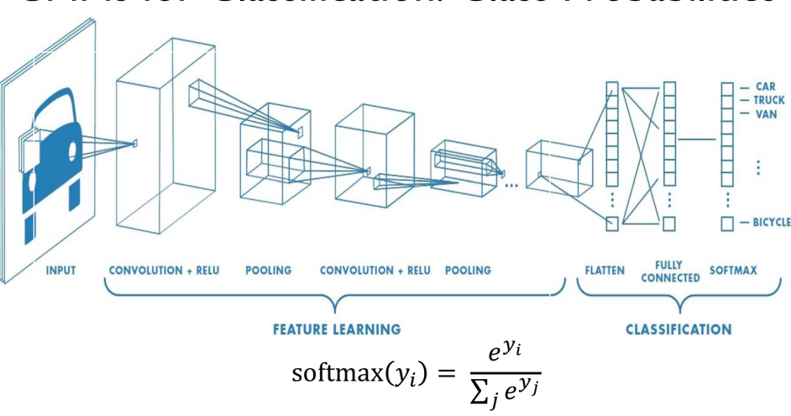

Slide 33
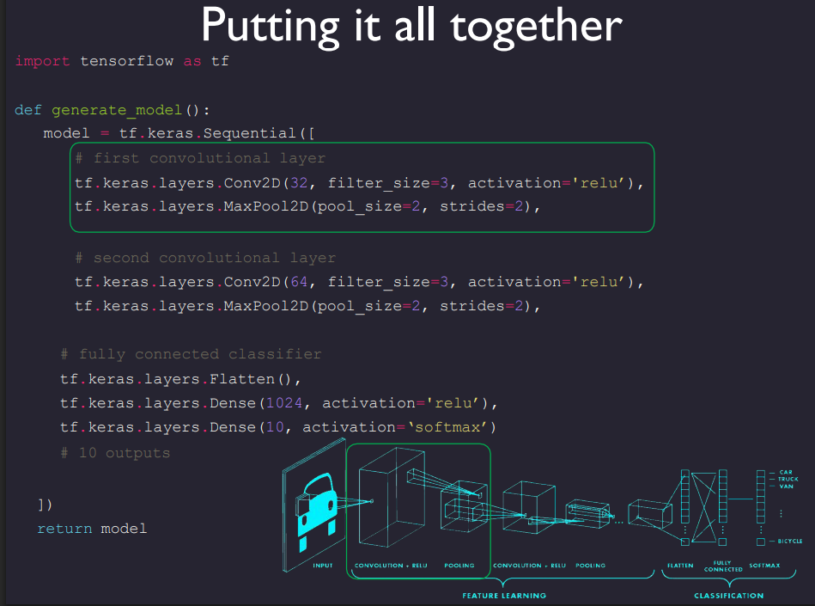

Slide 34
CASE STUDY _2 : Object Detection by YOLO

Slide 35
Q. : How can computers recognize objects?
Image as Numbers – Computer sees images as pixels (grids of numbers).
Feature Detection – CNN extracts features like edges, shapes, colors.
Pattern Learning – Deeper layers learn complex structures (eyes, faces, wheels).
Representation – Features are combined into meaningful patterns.
Classification – Final layer assigns probabilities to categories.
Prediction – Object with highest probability is recognized .
Challenge:
• Objects can be anywhere in the scene, in any orientation, rotation, color , etc.
• How can we overcome this challenge?
Answer:
• Learn a ton of features (millions) from the bottom up .
• Learn the convolutional filters, rather than pre-computing them.

Slide 36
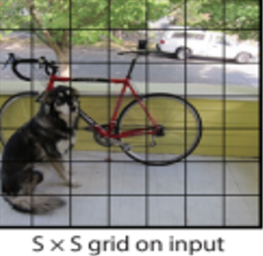
YOLO (YOU ONLY LOOK ONCE) :
YOLO model, which is a state-of-the-art CNN based image detection model that ”predicts bounding boxes and class probabilities directly from full images in one evaluation”.
YOLO divides the image into an S × S grid and for each grid cell predicts B bounding boxes, confidence for those boxes, and C class probabilities. These predictions are encoded as an S × S × (B*5 + C) tensor.
There are several model including object detection, segmentation, pose estimation, tracking, and classification, leveraging capabilities across diverse AI applications and domains. , we will discuss YOLOv11 for an example.
How does YOLO detect the object ?
Step 1: Grid Partitioning
Input image divided into an S × S grid.
Each grid cell predicts:
Bounding boxes (location, width, height).
Confidence score (probability object exists).
Class probabilities (object category).

Slide 37
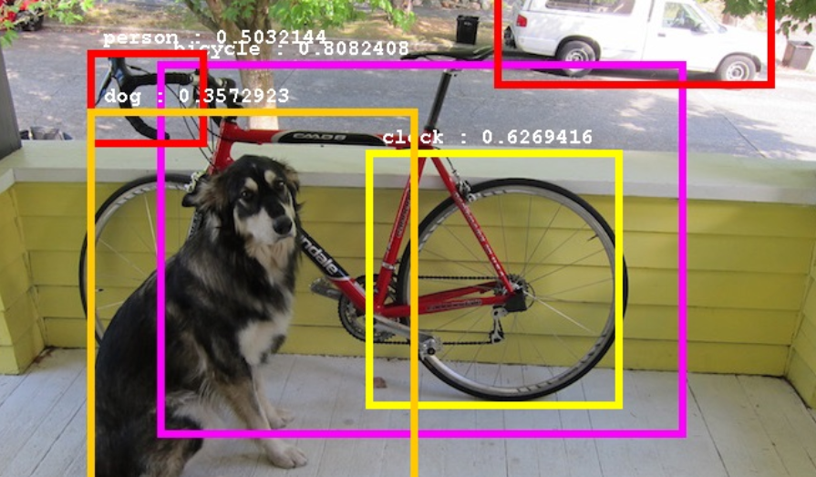
Step 2: Bounding Boxes & Confidence
Each cell can predict multiple bounding boxes.
Confidence score = Objectness Score × IOU (with ground truth).
Initially, many overlapping boxes are generated.
Step 3: Class Probability Map
Each grid cell outputs conditional class probabilities.
Combines with bounding box confidence → final detection score.
Helps distinguish between classes .
Step 4: Final Detections
Apply Non-Maximum Suppression (NMS) to remove redundant overlapping boxes.
Retain only the bounding boxes with highest confidence.
Output: Clean detections with labeled bounding boxes.
Note :
Non-Maximum Suppression (NMS)
(1) Model makes too many boxes for one object.
(2) NMS = box cleaner.
(3) Keeps the best box (highest score).
(4) Removes extra overlapping boxes.
(5) Final result = neat detection.

Slide 38
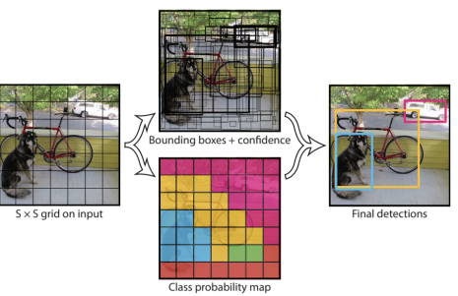

Slide 39

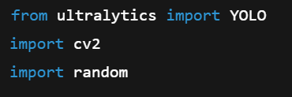
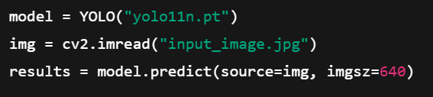
How to implement YOLO :
Object Detection

Slide 40
SOURCE :
https://www.geeksforgeeks.org/deep-learning/cnn-introduction-to-pooling-layer/
https://www.kaggle.com/learn/computer-vision
http://cs230.stanford.edu/projects_winter_2019/reports/15812659.pdf
https://www.kaggle.com/datasets/rehabalsayed/object-detection-for-different-images/code
https://cs231n.stanford.edu/slides/2022/lecture_5_ruohan.pdf
https://docs.ultralytics.com/tasks/detect/#predict
https://www.youtube.com/playlist?list=PLZ2ps__7DhBZVxMrSkTIcG6zZBDKUXCnM
https://mit6874.github.io/assets/sp2020/slides/L03_CNNs_MK2.pdf

Slide 41
THANK YOU
SATYAM KUMAR DUBEY

